Slide 1
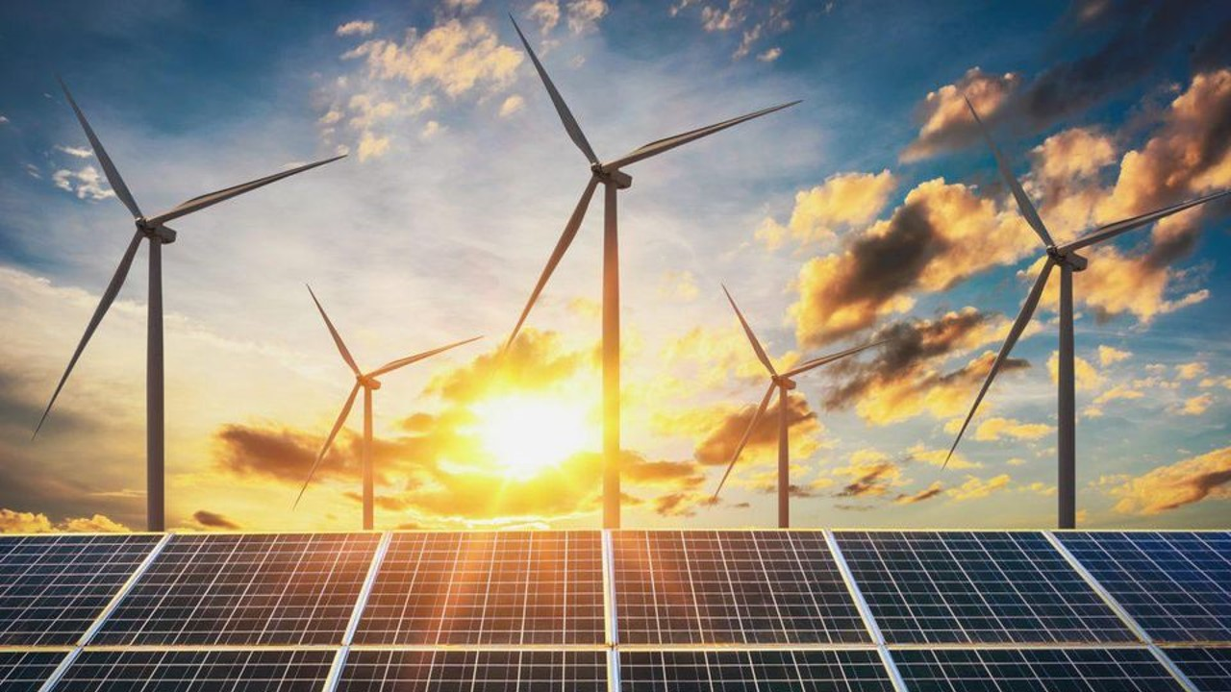





WP3 – Mesoscale modelling
Author: Jia Yu, Prof. Emmanuel Baudrin, Prof. Alejandro A. Franco*
ENERGIE
RS2E

Slide 2


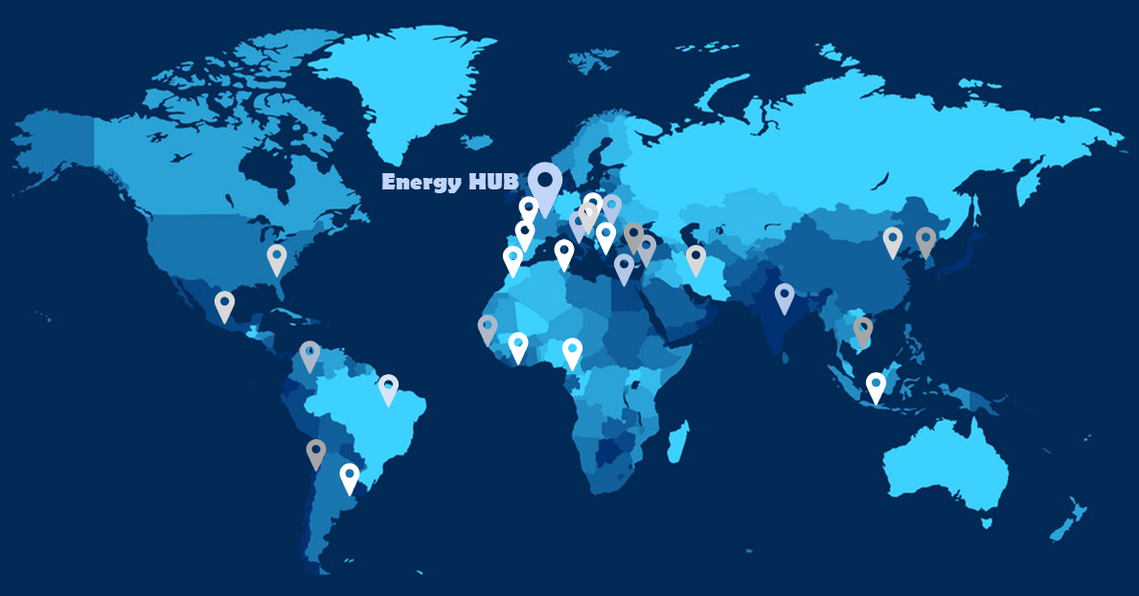



LRCS – CNRS @ Energy HUB, Université de Picardie Jules Vernes, Amiens, France
>125
Ph.D. students, post-docs, researchers, professors
5
General research themes
9
Battery technologies
11
Modeling methods
ENERGIE
RS2E
2

Slide 3
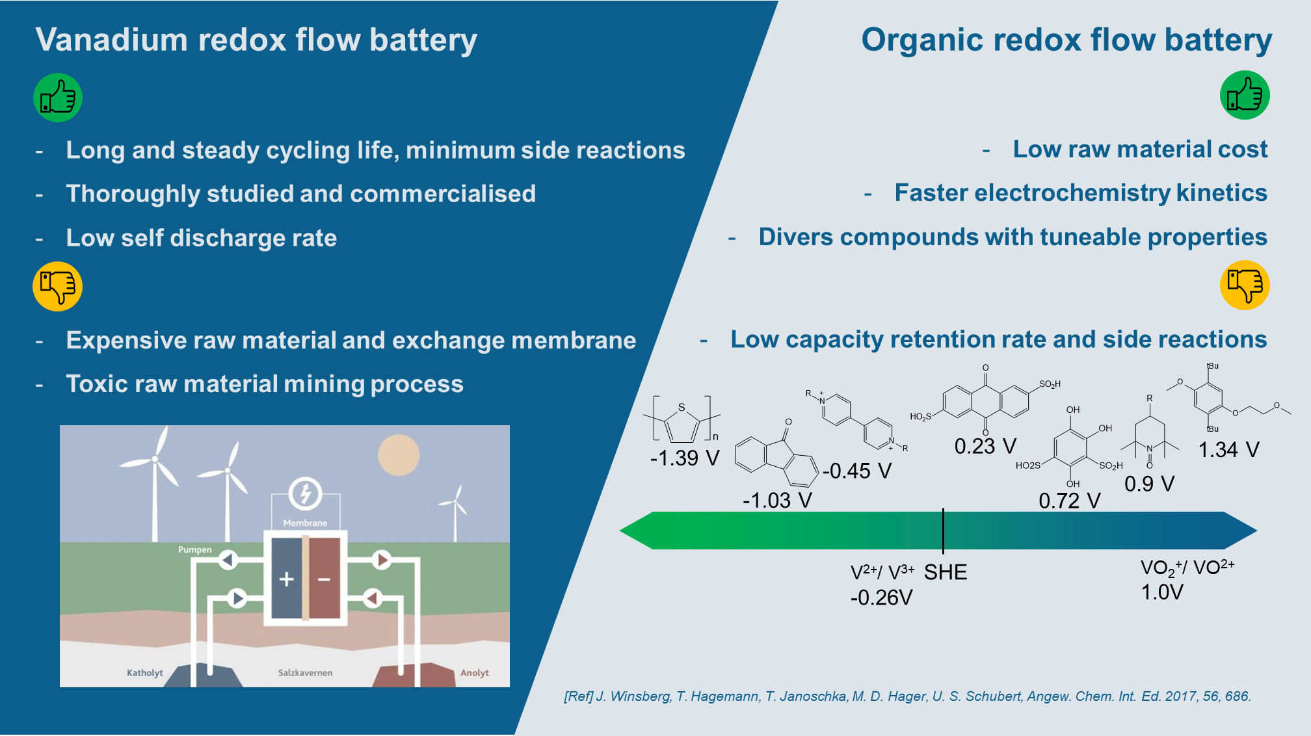
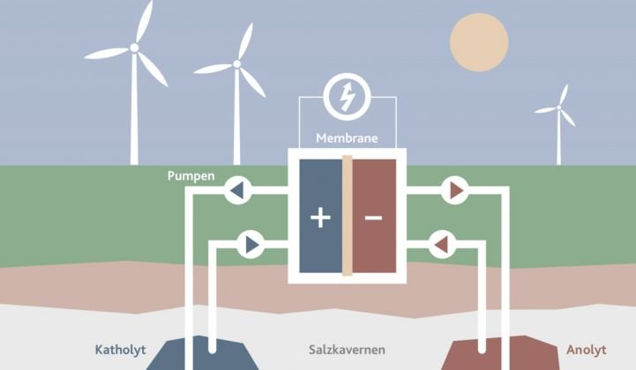
[Ref] J. Winsberg, T. Hagemann, T. Janoschka, M. D. Hager, U. S. Schubert, Angew. Chem. Int. Ed. 2017, 56, 686.
ENERGIE
RS2E
3
Notes:
Monte Carlo methods is a class of computational algorithms which rely on repeated random sampling to obtain numerical results.
Kinetic Monte Carlo methods aim to tackle the dynamic properties during a variety of phenomena, for example, diffusion, crystal growth and catalysis

Slide 4
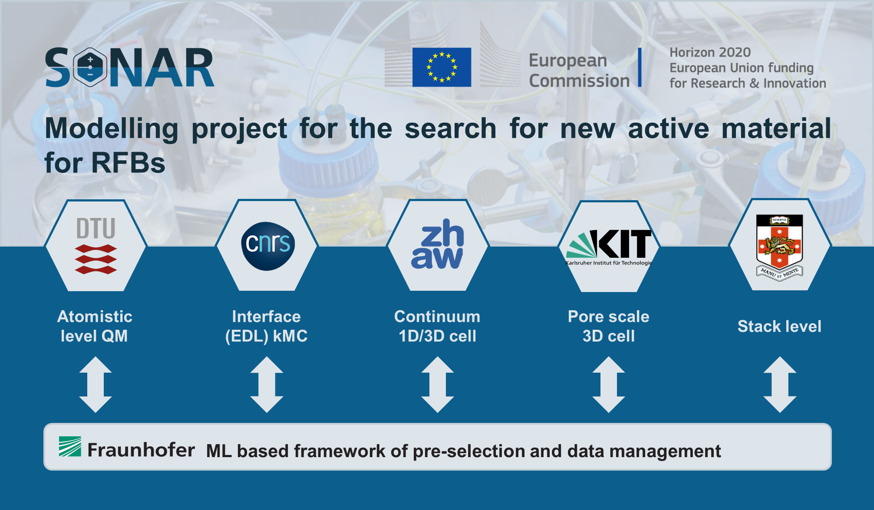
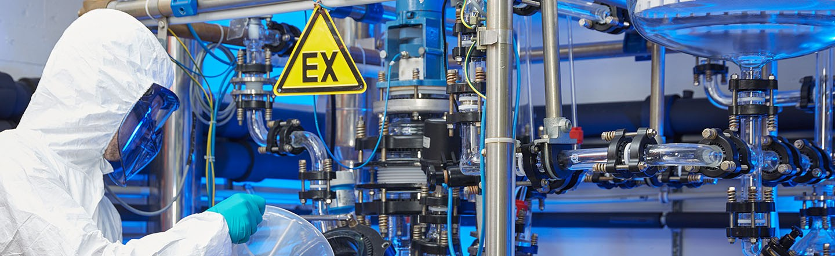
4

Slide 5

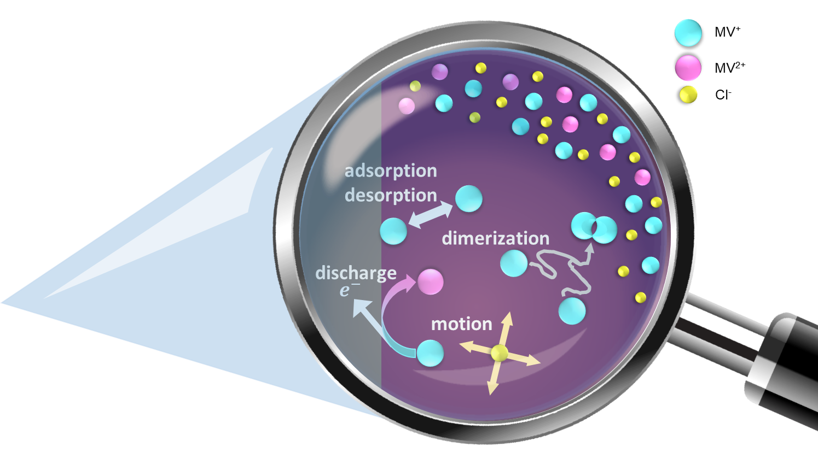
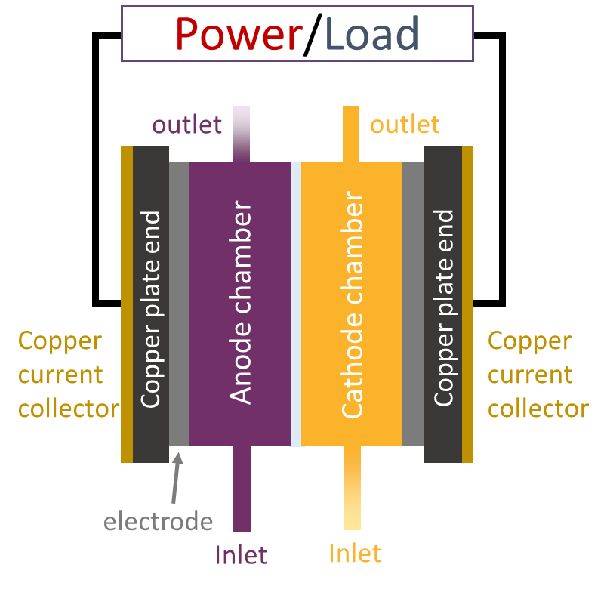
Target system – Methyl Viologen / 4-HO-TEMPO Organic RFB
MV⁺
MV²⁺
MV²⁺
4-HO-TEMPO
MV⁺
[4-HO-TEMPO]⁺
Cl⁻
[Ref] Adv. Energy Mater. 2016, 6, 1501449.
ENERGIE
RS2E
5

Slide 6
Section 1: Kinetic Monte Carlo model for electrode kinetics
https://doi.org/10.1002/smll.202270229
ENERGIE
RS2E
6

Slide 7
Qualitative comparison of interface kinetics
Electron transfer (Target event)
Driven and limited by free energy difference between initial and final states
Number of available particle
Dominant reactions
Particle displacement
Particle displacement
Diffusion driven by thermal motion
Migration driven by Electrical field
Limited by volume
Abundant
number
Dimerization
Disproportionation of dimers/multimers
Electron transfer
Dimerization & Disproportionation
Formation and breakage of chemical bond
Limited number
Adsorption / Desorption
Adsorption / desorption
Driven by Van der Waals forces
Kinetic rate
Slow
[Ref] ACS Appl. Energy Mater. 2020, 3, 9, 8833–8841.
Fast
ENERGIE
RS2E
7

Slide 8





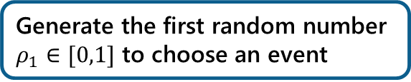








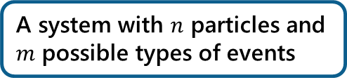


Kinetic Monte Carlo (kMC) algorithm
A system with $n$ particles and $m$ possible types of events
Check if the system meets the stop condition or not
Update the grid
adsorption / desorption
Yes
Stop the simulation
diffusion
reaction
No
Compile an event list with their rates
Generate the first random number $ρ_{1}∈[0,1]$ to choose an event
Generate the second random number $ρ_{2}∈[0,1]$ to update the simulation clock
$$∆t= \frac{−ln⁡(ρ_{2})}{K_{tot}}$$
$$k_{11}$$
$$k_{12}$$
$$k_{21}$$
$$k_{n m−1}$$
$$k_{nm}$$
$$k_{11}$$
$$k_{12}$$
$$k_{21}$$
$$k_{n m−1}$$
$$k_{nm}$$
$$∙∙∙$$
$$∙∙∙$$
$$K_{total}$$
$$ρ_{1}K_{total}$$
[Ref] Journal of The Electrochemical Society, 163 (2) F59-F70 (2016).
ENERGIE
RS2E
8
Notes:
Monte Carlo methods is a class of computational algorithms which rely on repeated random sampling to obtain numerical results.
Kinetic Monte Carlo methods aim to tackle the dynamic properties during a variety of phenomena, for example, diffusion, crystal growth and catalysis

Slide 9
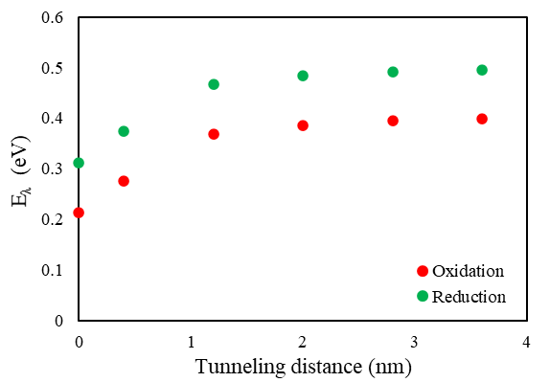

KMC events & event rates – Part I
Electrochemical reaction event
Long distance tunnelling according to Marcus-Hush theory
Inner reorganisation energy $E_{λ_{i}}$ obtained from DFT calculation
Total reorganisation energy
$$E_{λ}=E_{λ_{i}}+\frac{q^{2}}{8π}(\frac{1}{ε_{op}}−\frac{1}{ε_{st}})(\frac{1}{a}−\frac{1}{2R})$$
Electrochemical reaction rate $k_{rea}$
Eyring equation
$$k_{reac}=κ\frac{k_{B}T}{h}exp⁡(\frac{−E_{λ}∓f\left(σ\right)}{RT})$$
ENERGIE
RS2E
9

Slide 10
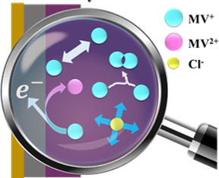

KMC events & event rates – Part II
Hopping event
Diffusion and migration considered
Convection neglected
Hopping rate $k_{hop}$
Diffusion factor $D_{diff}$ calculated from Stokes-Einstein equation
$$D_{diff}=\frac{k_{B}T}{6πμr}$$
Hopping rate $k_{hop}$ obtained by combining $D_{diff}$with electrical field factor
$$k_{hop}=D_{diff}exp⁡(\frac{q_{i}El}{k_{B}T})$$
Degradation event
Dimerization followed by disproportionation and MV⁰ precipitates out (one event only)
Degradation rate obtained form DFT calculation
Adsorption and desorption events
Energy barrier of adsorption and desorption obtained from DFT calculation
Adsorption/desorption impact taken into account
ENERGIE
RS2E
10

Slide 11
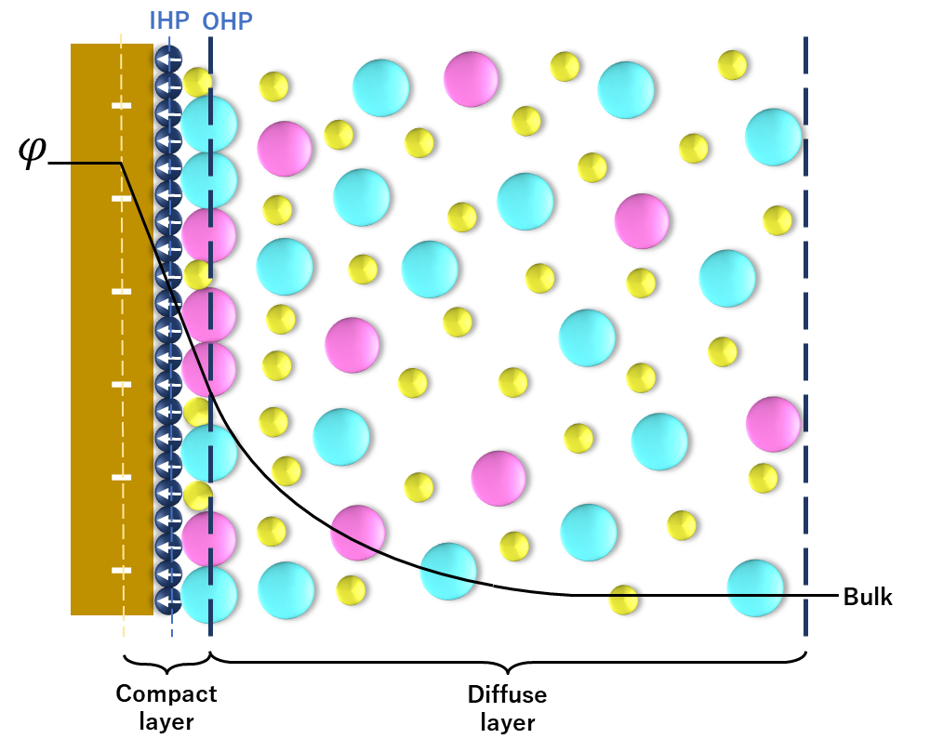
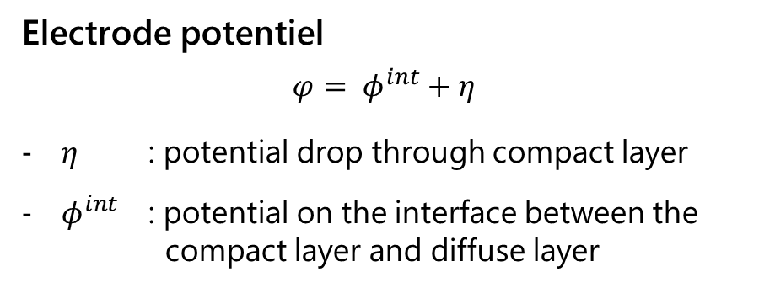
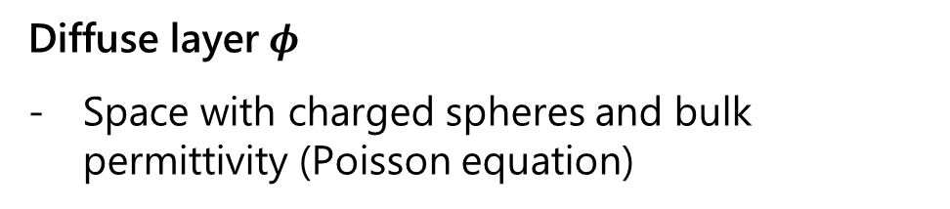
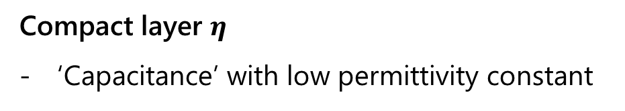
Electrical Double Layer approach
Electrical Double Layer (EDL) approach
Electrode potentiel
$$φ= φ^{int}+η$$
$η$ : potential drop through compact layer
$φ^{int}$ : potential on the interface between the compact layer and diffuse layer
Compact layer $η$
‘Capacitance’ with low permittivity constant
Diffuse layer$φ$
Space with charged spheres and bulk permittivity (Poisson equation)
[Ref] Journal of The Electrochemical Society, 153 (6) A1053-A1061 (2006).
ENERGIE
RS2E
11

Slide 12
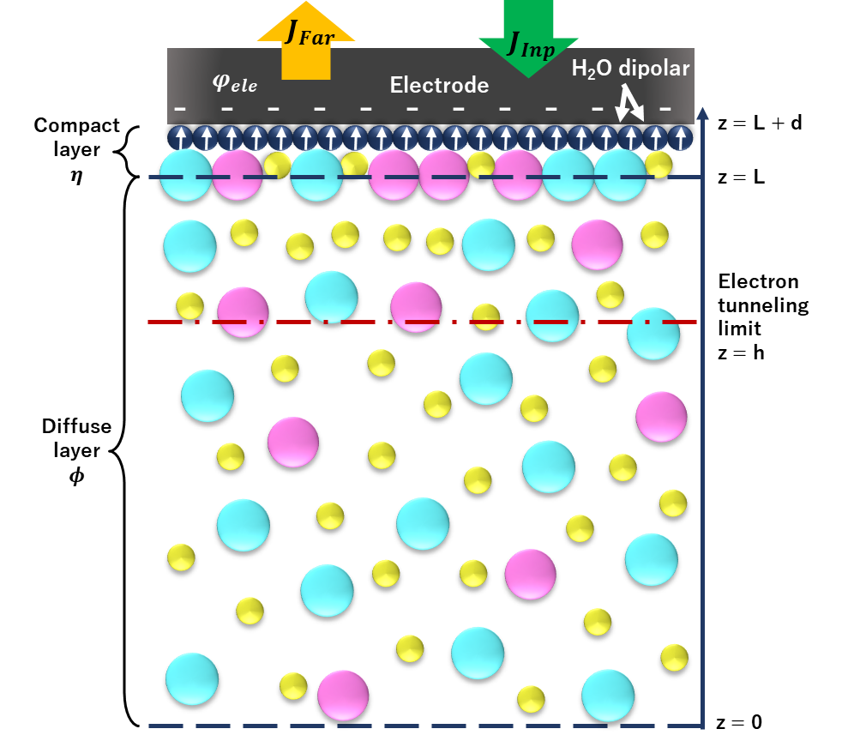
Electrical Double Layer approach coupled with kMC model
Initial state
Get rate list
Choose event
Execute event
kMC algorithm
Update inputs for EDL model
Update different kinetics
Solve EDL model
ENERGIE
RS2E
12

Slide 13
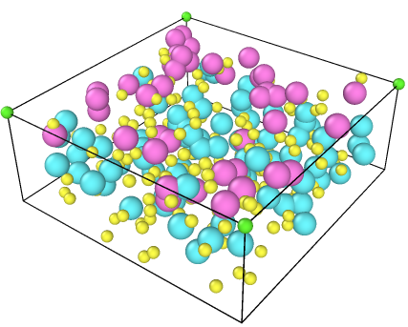
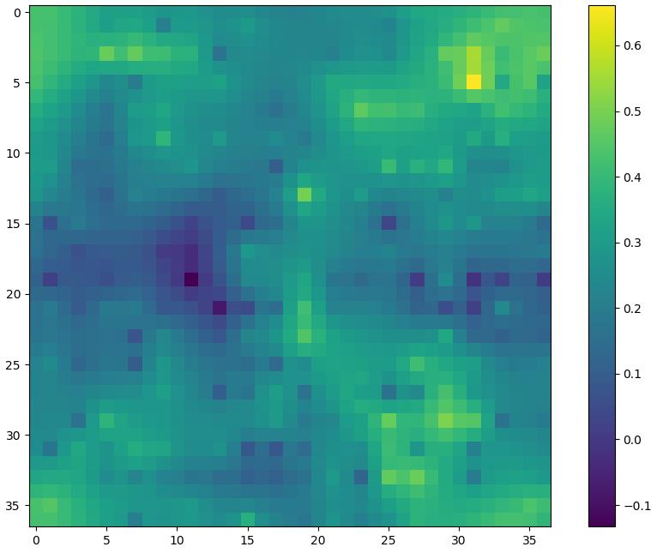
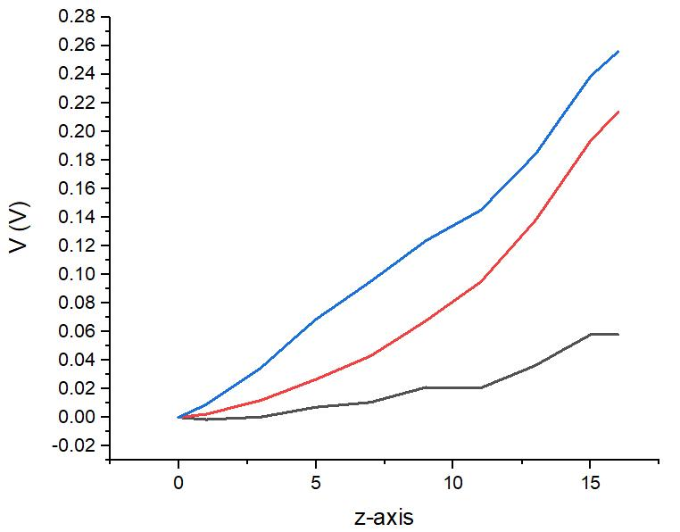
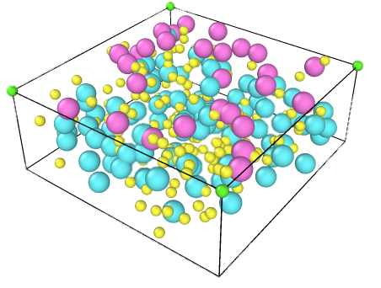
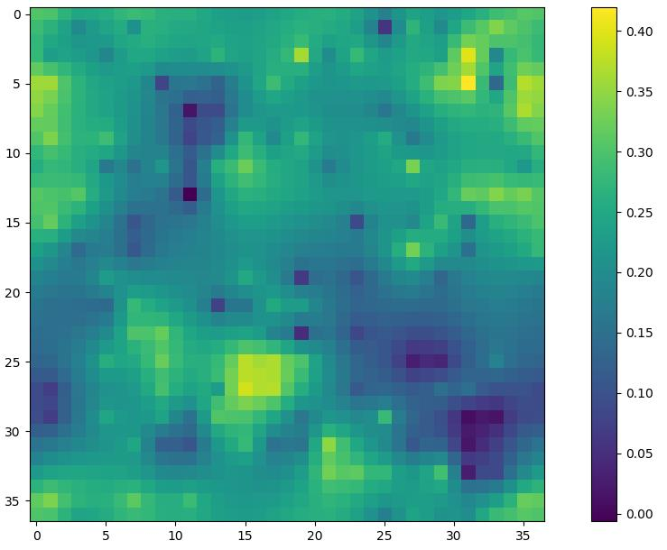
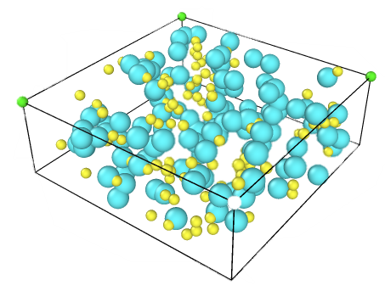
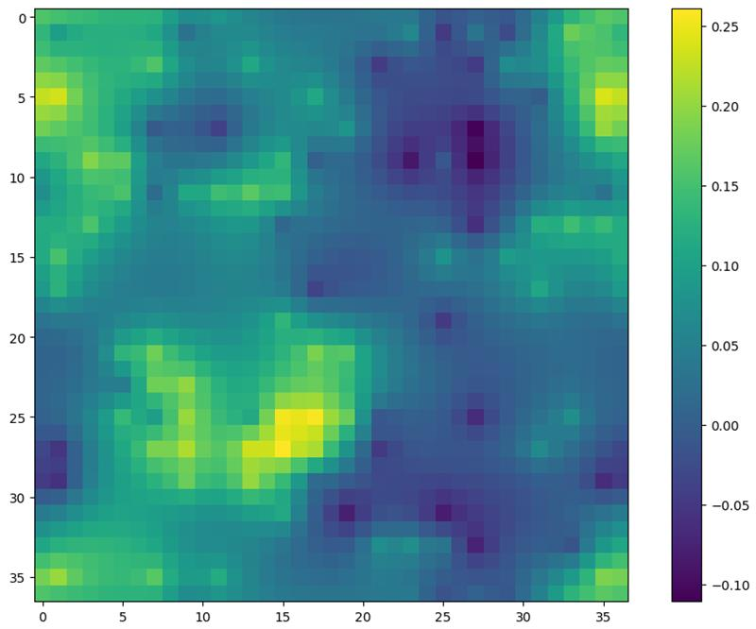



Electrical field distribution inside the simulation box
Potential drop through the diffuse layer
0.6V
-0.1V
Furthest plane from the electrode surface
$$φ^{inter}$$
End of the simulation
0.4V
0 V
$$φ (V)$$
Beginning of simulation
0.25V
-0.1 V
$$∇^{2}ϕ=−\frac{ρ}{ε_{0}ε_{DL}}$$
Z axis coordinate
Cl⁻
MV²⁺
MV⁺
ENERGIE
RS2E
13

Slide 14
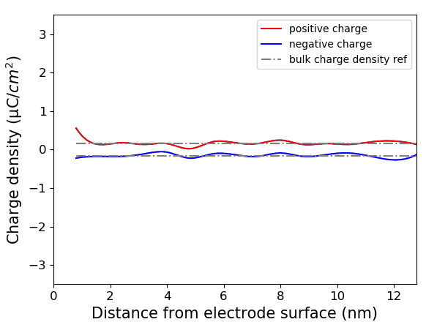
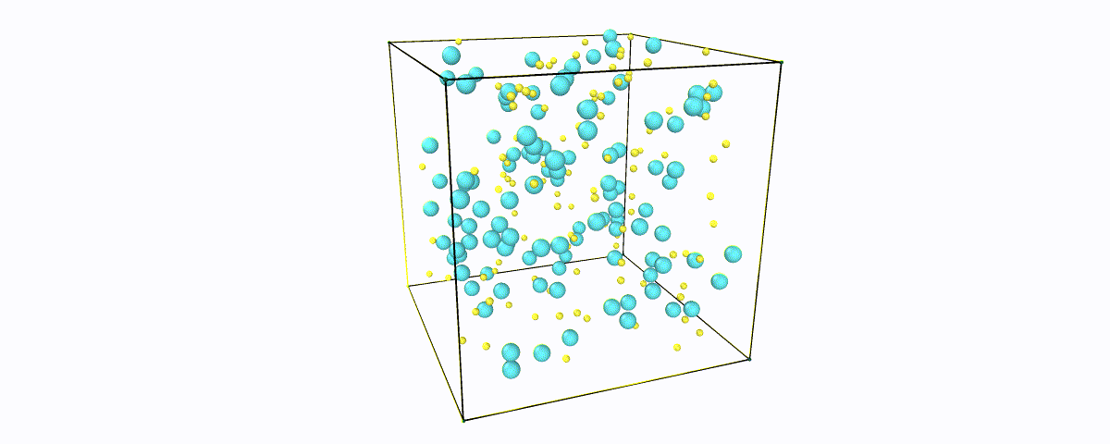
Formation of Electrical Double Layer
1 Debye length simulation box
Charge density profile
Cl⁻
MV²⁺
MV⁺
ENERGIE
RS2E
14

Slide 15
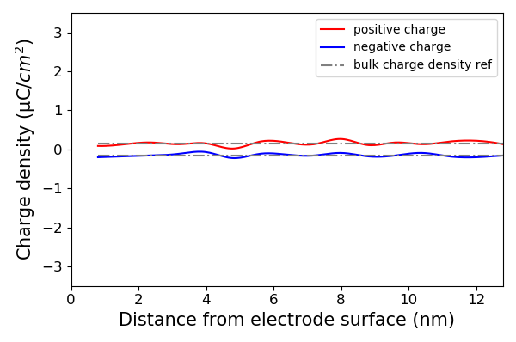
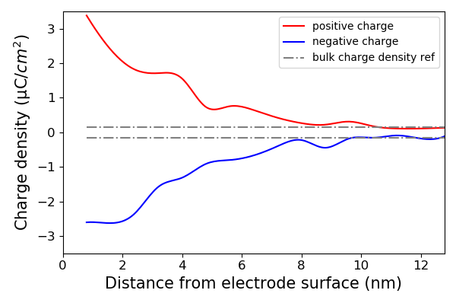
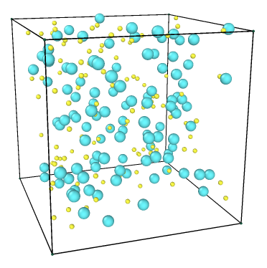
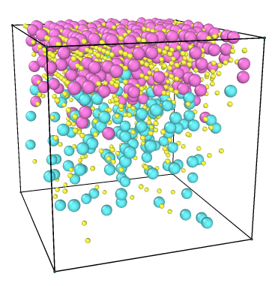
Formation process of Electrical Double Layer
Charge density profile – Before discharge
Charge density profile – After discharge
Instead of a monotonous charge distribution profile from classic Gouy-Chapman-Stern model, the EDL structure obtained from kMC demonstrates the fluctuation of positively charged molecules and negatively charged molecules.
ENERGIE
RS2E
15

Slide 16
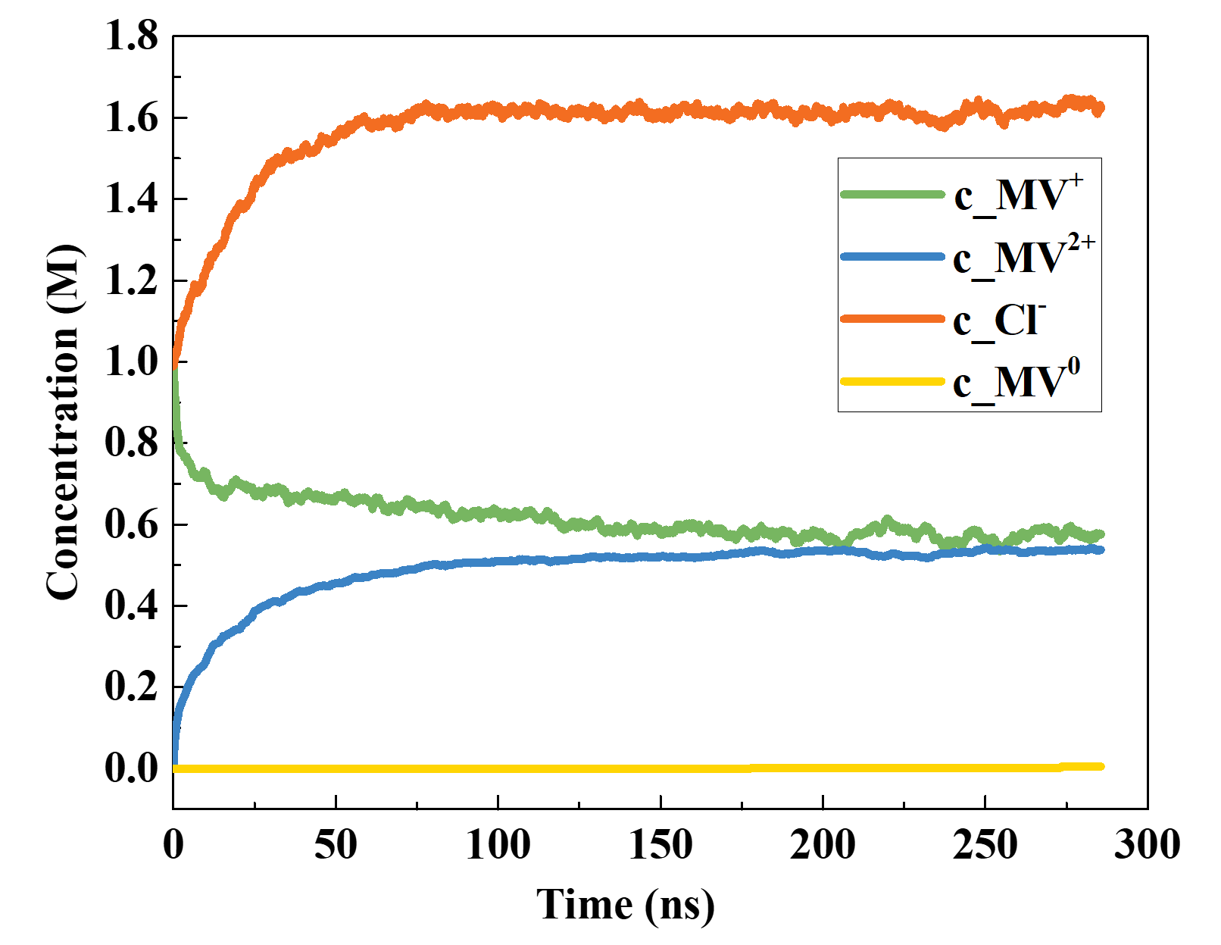
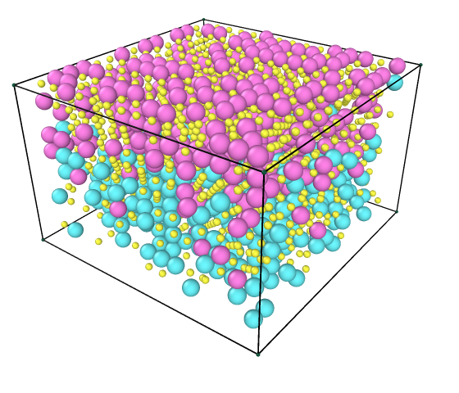
Single discharge case
Concentration evolution during discharge
Potential evolution during discharge
MV²⁺
MV⁺
MV⁰
Cl⁻
The concentration of MV^{+·}, MV²⁺, and Cl⁻ reach a steady level after the activation state of the model.
Disproportionation is barely observed due to low kinetic rates.
ENERGIE
RS2E
16

Slide 17
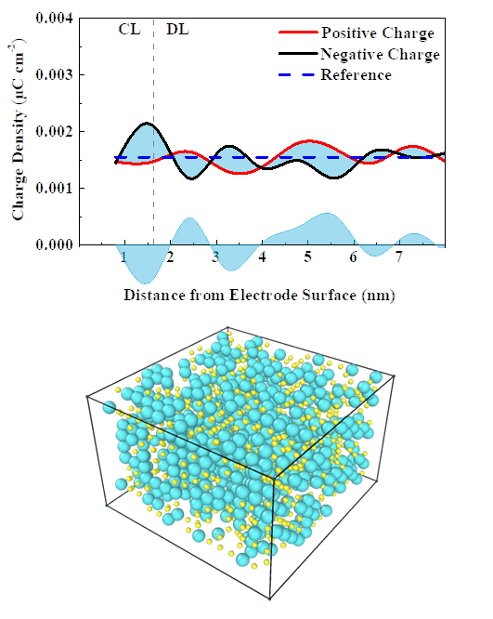
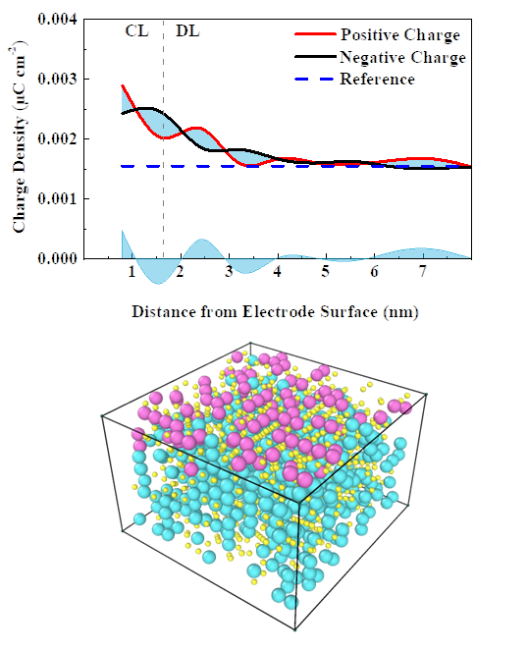
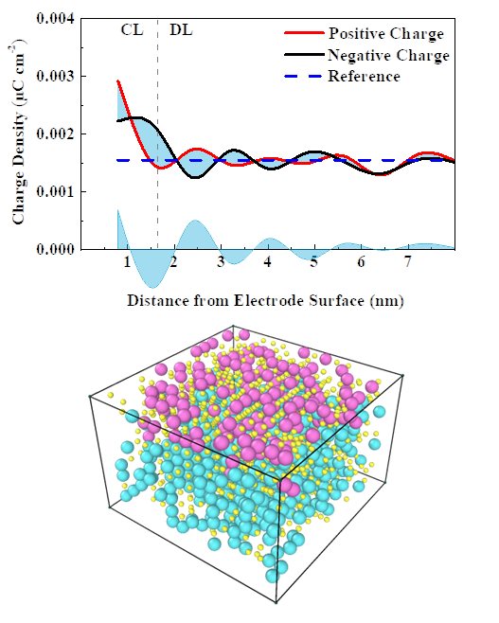
Formation of Electricla Double Layer structure
Formation of the double layer structure inside the Debye length
The oscillation of the positive and negative chage is due to the explicit description of charged ions
ENERGIE
RS2E
17

Slide 18
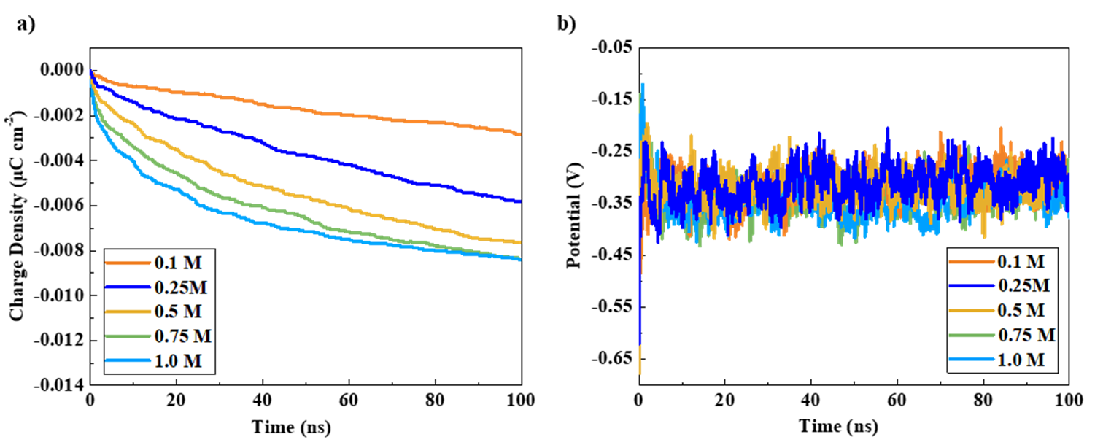
Impact of concentration on electrochemical kinetics
Higher concentration system respond faster to the input signal due to less available site on the electrode surface.
ENERGIE
RS2E
18

Slide 19
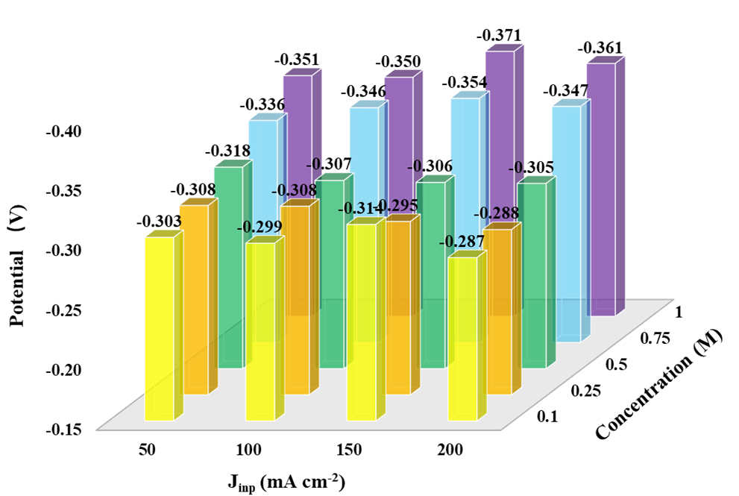
Impact of concentration on electrochemical kinetics
KMC model developed for fast outer sphere electron transfer.
Higher concentration leads to a lower steady-state potential, due to the more compact EDL structure.
Not sensitive enough to the input current densities, due to the time scale not large enough, since the current is taken into account by integral throughout time
ENERGIE
RS2E
19

Slide 20
Conclusion – Section 1
KMC model
Interfacial electrochemical kinetics
EDL model
Ionic transport & electrostatic impact
Global system performance
ENERGIE
RS2E
20

Slide 21
Section 2: Lattice Boltzmann Method for electrolyte convection
https://doi.org/10.1016/j.jpowsour.2023.233182
ENERGIE
RS2E
21

Slide 22
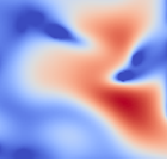
Lattice Boltzmann Method (LBM)
A modern approach in Computational Fluid Dynamics (CFD) considered as a class of kinetic theory
A method considers behavior of a collection of particles as a unit
Navier-Stokes equation
LBM
Molecular Dynamics
velocity, pressure
distribution functions
particle position and momentum
macroscale
mesoscale
microscale
ENERGIE
RS2E
22

Slide 23
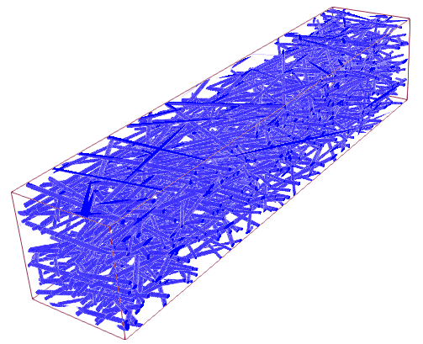
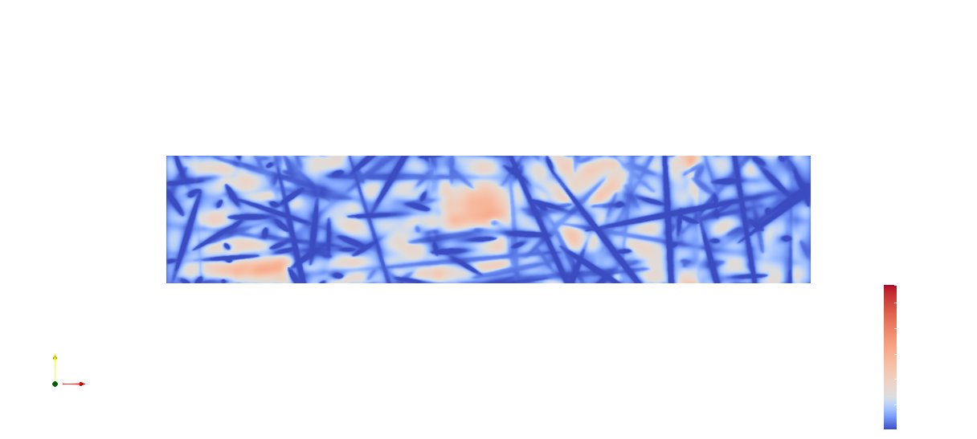
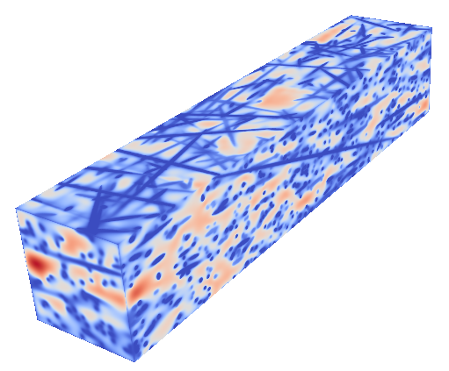
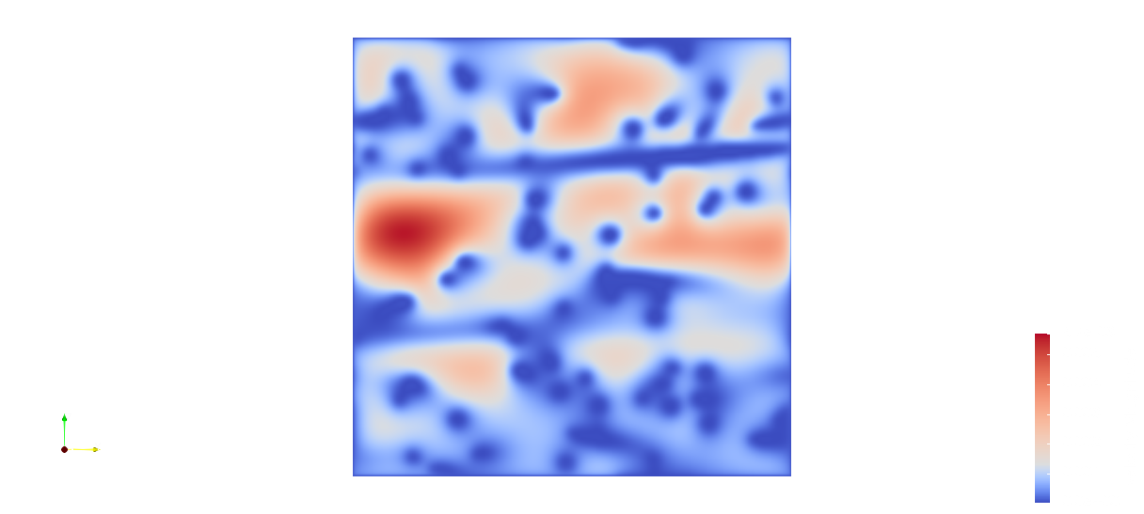
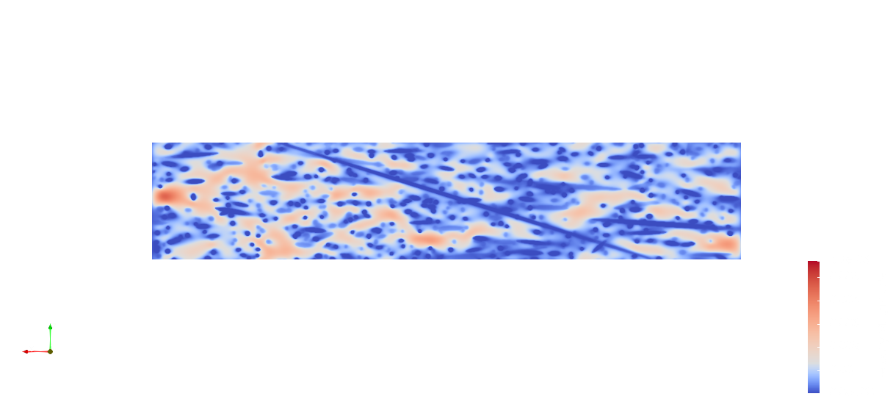
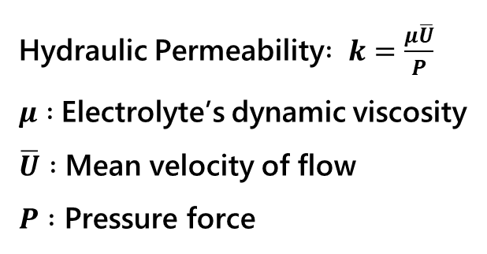
Lattice Boltzmann Method
Velocity distribution of the electrolyte flow
Direction of the electrolyte flow
Hydraulic Permeability$: k=\frac{μ\overline{U}}{P}$
$μ :$Electrolyte’s dynamic viscosity
$\overline{U} :$ Mean velocity of flow
$P :$ Pressure force
ENERGIE
RS2E
23

Slide 24
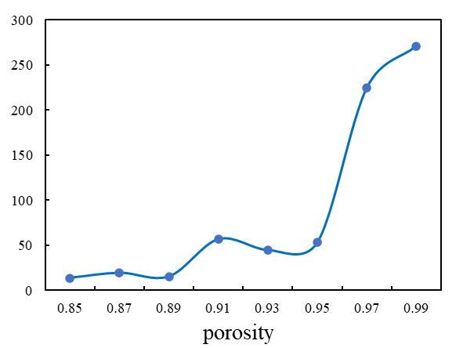
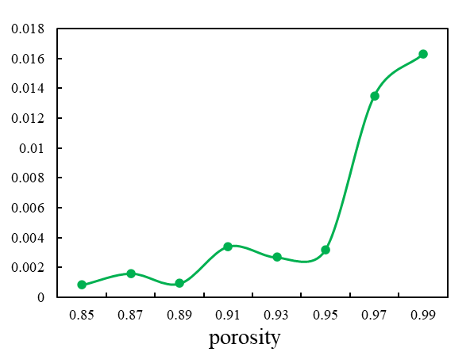


Porosity Vs. Hydraulic Permeability of carbon felt electrode
Hydraulic permeability (µm²)
Fluid velocity (lu.)
Impact of electrode porosity on permeability and fluid velocity under same inlet pressure.
Higher porosity → Higher hydraulic permeability and velocity, except stranger points
ENERGIE
RS2E
24

Slide 25





Optimization Objective
Fast electron transfer
Maximise Hydraulic Permeability (k)
Maximise specific surface area (SSA)
Maximise Practical Reactive Volume ($η_{PRV}$)
Electrolyte utilization rate
Even electrolyte distribution
Maximum specific area
Thick fiber
High Porosity
Low Compression ratio
Thin Fiber
Low Porosity
High Compression ratio
Optimisation function : $min(\frac{1}{3}{\left(1−SSA\right)}^{2}+\frac{1}{3}\left(1−η_{PRV}\right)+\frac{1}{3}\left(1−k\right))$
ENERGIE
RS2E
25

Slide 26

Optimization workflow and parameter sets
Parameter | Min value | Max value
Fiber diameter (µm) | 4.70 | 22.3
Density (g/cm³) | 0.08 | 0.15
Fiber orientation | 1.0 | 9.0
Amount of through-plane fiber (%) | 0.5 | 10
Compression ratio (%) | 1.0 | 40.0
Respective Porosity | 0.89 | 0.94
Apparent SSA (m²/m³) | 10000 | 77000
ENERGIE
RS2E
26

Slide 27
Optimization Results
The correlation between each two properties is captured.
Data point on the upper right corner has better C_{f} value.
The optimal case demonstrates a better permeability with similar SSA compared to reference cases.
ENERGIE
RS2E
27

Slide 28

The Optimal Case
Parameter | Min value
Fiber diameter (µm) | 22.3
Area density (g/cm²) | 0.08
Fiber orientation | 8.55
Amount of through-plane fiber (%) | 2.30
Compression ratio (%) | 32.6
Alignment is favored for fiber orientation apart from the through-plane fibers.
Bulk porosity at 0.90 after compression.
Thick fibers with high compression ratio lead to heterogeneous porosity distribution across the compression direction, and facilitate the mass transport.
ENERGIE
RS2E
28

Slide 29



The Reconstructed Optimal Case and Pore Analysis
Compression increases the amount of small pores.
The porosity is generally decreased after the compression.
Porosity decreased more near to the compression plane .
A PSD with a small part of large pores is in favor for a better cell design.
Compression
Journal of Power Sources, Volume 447, 31 January 2020, 227249
ENERGIE
RS2E
29

Slide 30

Electrochemical behaviour comparison – homogeneous model
The optimal case batter performed in both charge and discharge
The optimal case demonstrated a higher reversible capacity
The high SSA case has low over potential at the beginning, but the optimal case over performed by the end of charge and discharge
ENERGIE
RS2E
30

Slide 31

Conclusion & Perspective – Section 2
Propose a computational workflow for felt electrode microstructure optimization.
240 parameter sets are analyzed by Bayesian Optimizer.
The predicted optimal case combines thick fiber with high compression ratio.
Heterogeneity of pore size distribution facilitates mass transport.
ENERGIE
RS2E
31

Slide 32












RFB Research team in LRCS - CNRS
jia.yu@u-picardie.fr
alejandro.franco@u-picardie.fr
SCAN FOR MORE
https://www.linkedin.com/in/jiayu940918/
Jia Yu
Noura Rahbani
Théo Lotenberg
Corentin Bellay
@Jmmmm_YJ
@Prof_AA_Franco
https://www.sonar-redox.eu/en/About.html
Dr. Matthieu Becuwe
Prof. Dominique Larcher
Prof. Emmanuel Baudrin
Prof. Alejandro A. Franco
ENERGIE
RS2E
32

Slide 33

Acknowledgement
Funding
Prof. Alejandro A. Franco
Prof. Emannuel Baudrin
Dr. Piotr De Silva
Dr. Jens Noack
Dr. Astrid Maas
Dr. Roman Pascal Schärer
Dr. Gaël Mourouga
Marc Duquesnoy
Jiahui Xu
Chaoyue Liu
Grant Agreement #875498
https://www.sonar-redox.eu
Thank you for your attention.
ENERGIE
RS2E
33

Slide 34

Comparison between different SSA measurements
Minkowski measures calculated SSA demonstrates a linear correlation with the apparent SSA
Voxel mesh calculated SSA is much higher compared to the apparent SSA
ENERGIE
RS2E
7

