Slide 1
Discovery of degradation mechanisms of electroactive molecules
Sankt Augustin, September 2023

Slide 2
Outline
Introduction: Background and motivation
Methodology: Automated reaction path search algorithm + electronic structure calculations
Model case: Benzoquinone in water
Summary

Slide 3
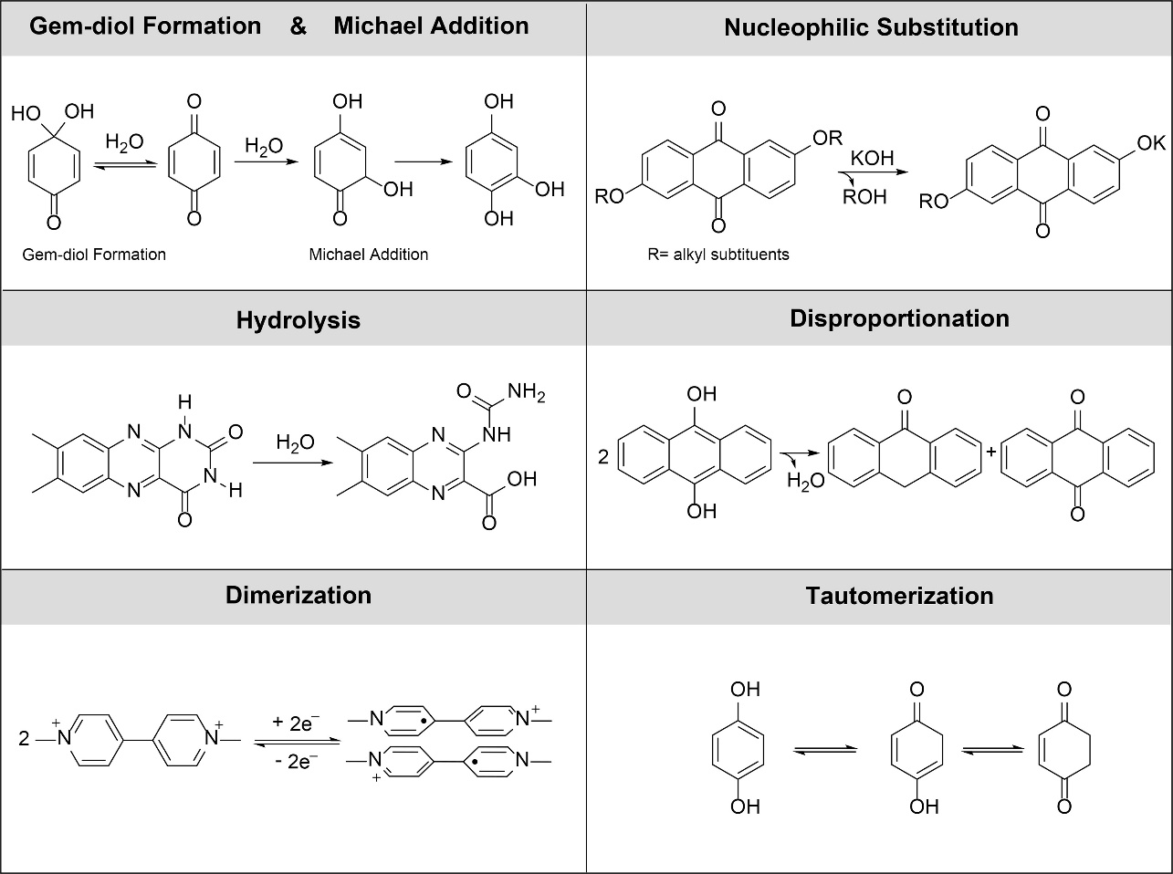
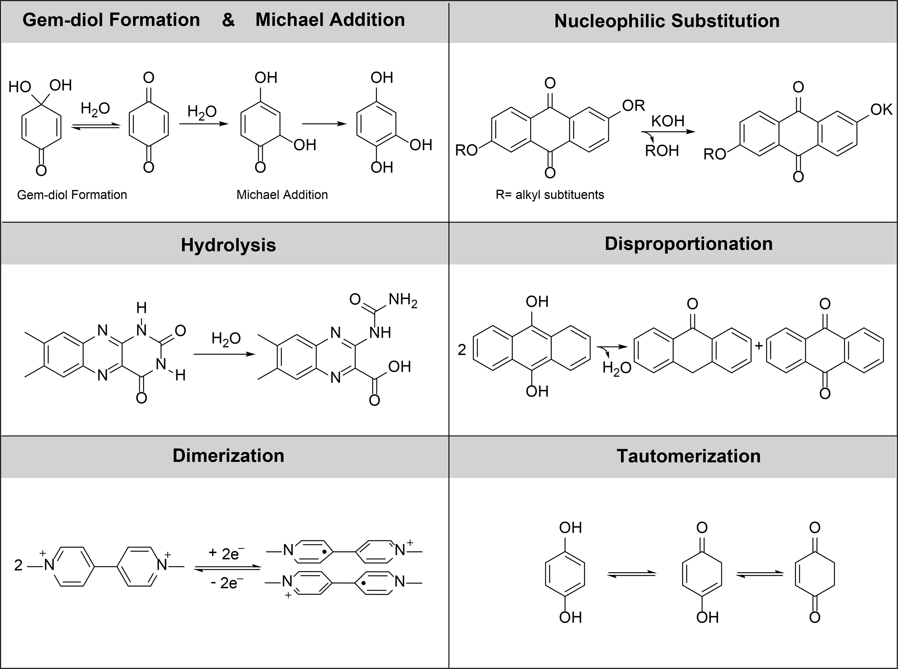

Motivation
Degradation of electrolytes is the major challenge for organic RFBs.
Degradation products are unknown a priori
Large chemical space to search
Possible attack sites
Chem. Rev. 2020, 120, 14, 6467-6489

Slide 4
Automated reaction path search algorithm
Reactant A
(Electrolyte)
Reactant B
Local reactivity
Local reactivity
Configuration generator
Process search
Intermediate
Product
Reaction mechanism

Slide 5
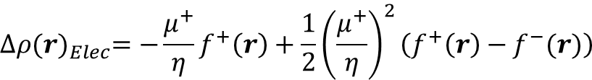
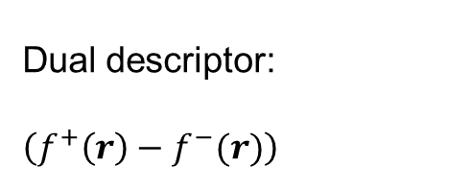
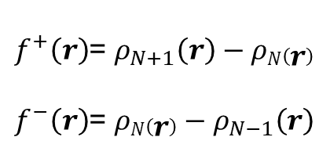
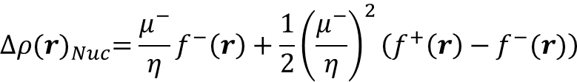
Local reactivity analysis
Local electrophilicity:
Fukui function:
$${∆ρ(r)}_{Elec}=−\frac{μ^{+}}{η}f^{+}\left(r\right)+\frac{1}{2}{\left(\frac{μ^{+}}{η}\right)}^{2}\left(f^{+}\left(r\right)−f^{−}(r)\right)$$
$f^{+}\left(r\right)$= $ρ_{N+1}\left(r\right)−ρN\left(r\right)$
$f^{−}\left(r\right)$= ${ρN\left(r\right)−ρ}_{N−1}\left(r\right)$
Local nucleophilicity:
Dual descriptor:
$$\left(f^{+}\left(r\right)−f^{−}(r)\right)$$
$${∆ρ(r)}_{Nuc}=\frac{μ^{−}}{η}f^{−}\left(r\right)+\frac{1}{2}{\left(\frac{μ^{−}}{η}\right)}^{2}\left(f^{+}\left(r\right)−f^{−}(r)\right)$$
Chem. Sci., 2021,12, 6264-6279
Phys. Chem. Chem. Phys., 2014, 16,26832
Notes:
5

Slide 6
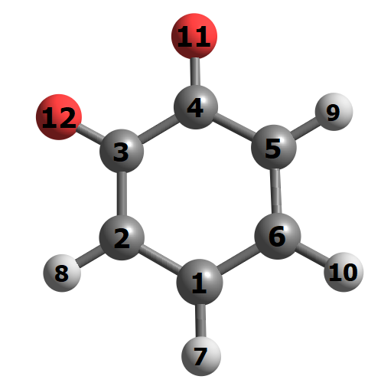
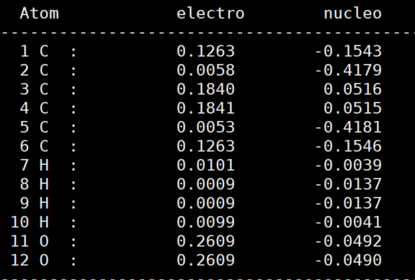
Local reactivity analysis

Slide 7
Configuration generator
Local reactivity analysis
Configuration generator
Local electrophilicity
Sorting..
Vec1
COG
COG
Vec2
Align to -Vec1
Electrophile
R_{hot1_hot2}
Local nucleophilicity
H
Nucleophile
Electrophile(Mol1)
Nucleophile(Mol2)
Notes:
7

Slide 8
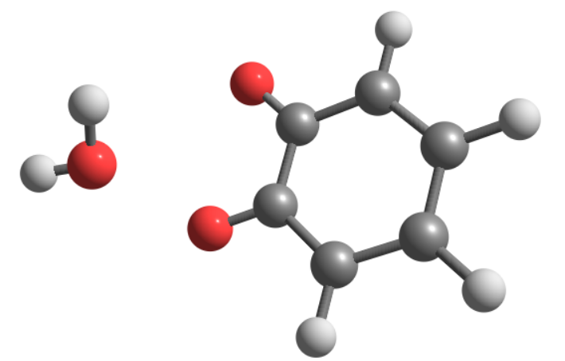
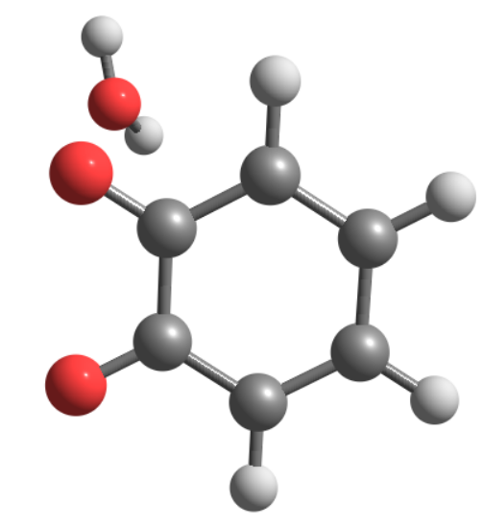
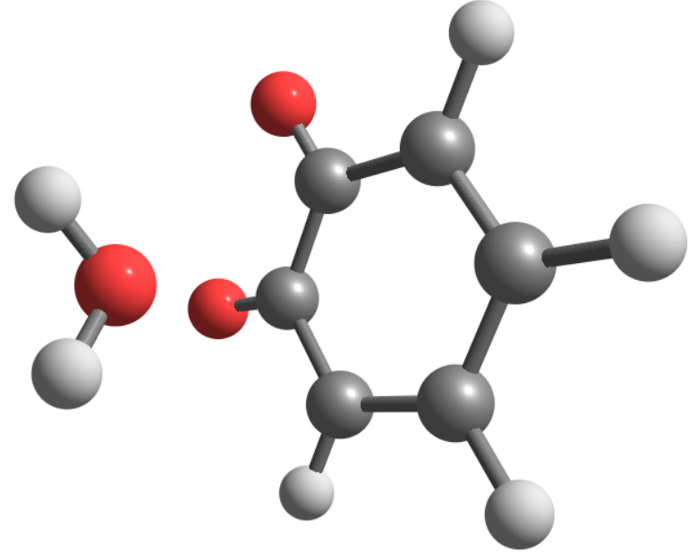
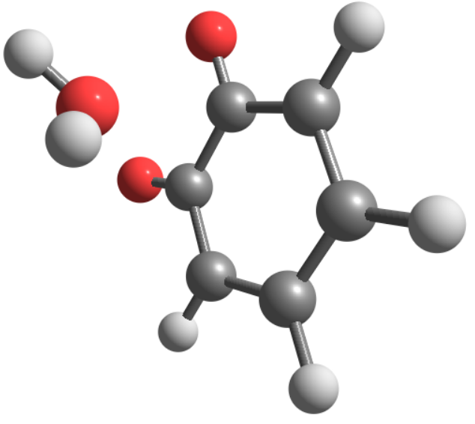
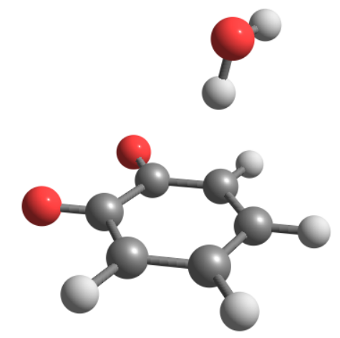
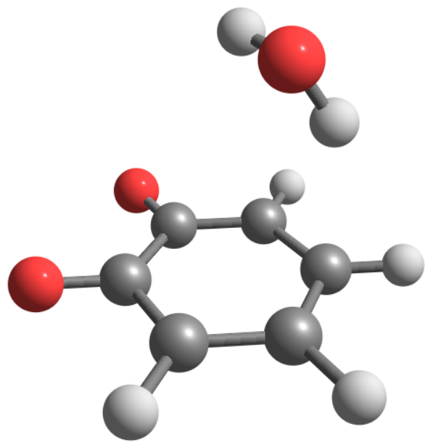
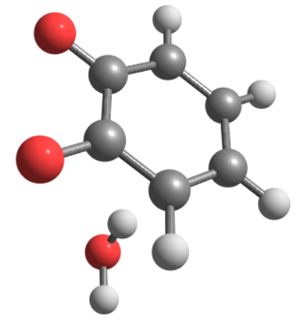
Configuration generator
Nucleophile
Electrophile
D_{nuc_elec}= 2.2 Å
…
Notes:
8

Slide 9
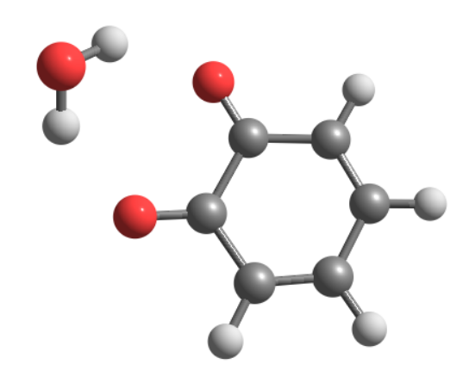
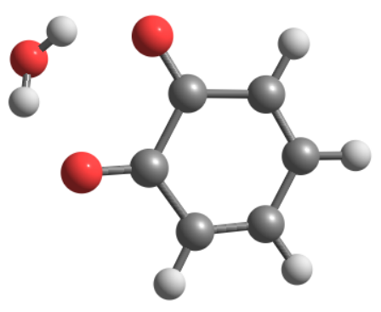
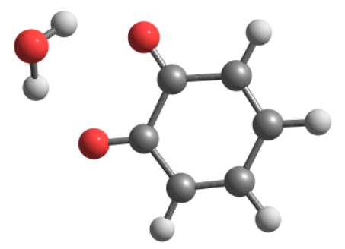
Configuration generator
Geometry optimization (DFTB3)
Apply energy filter, cut-off value = 0.00005 eV
Adjust the value to change the number of potential candidates

Slide 10
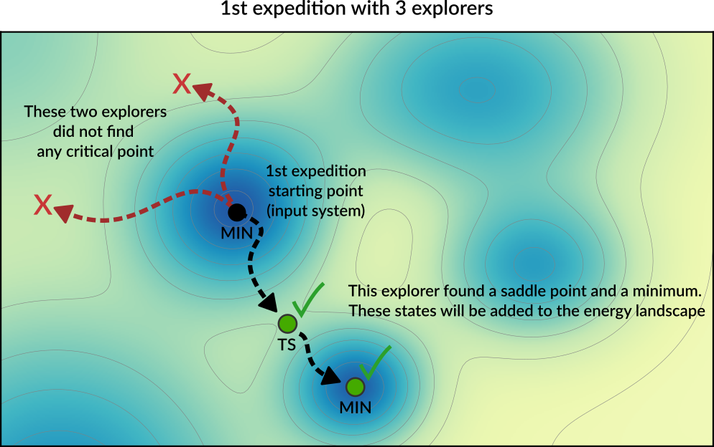
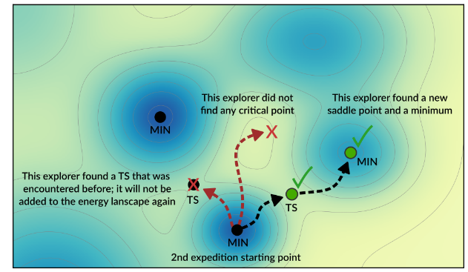
Process search
Algorithm:
  Send several explorers
  One-ended search for a saddle point (minimum-mode following)
  Minimization of two images placed on both sides of the TS
  Add saddle point and minima to a database (exclude duplicates)
  Start a new expedition
https://www.scm.com/doc/AMS/Tasks/PES_Exploration.html

Slide 11
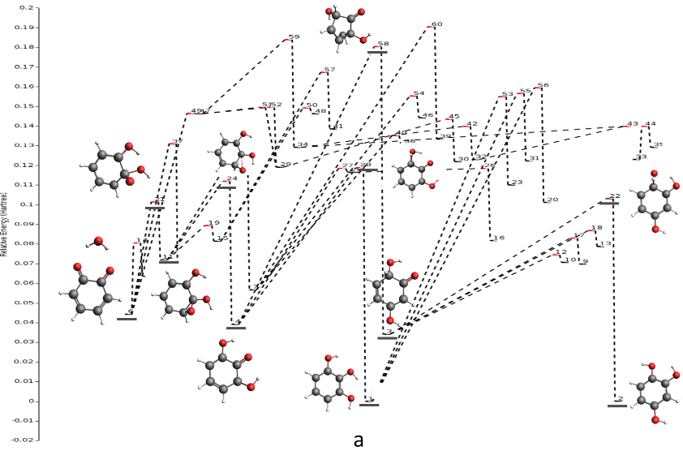
Michael addition reaction of BQ

Slide 12
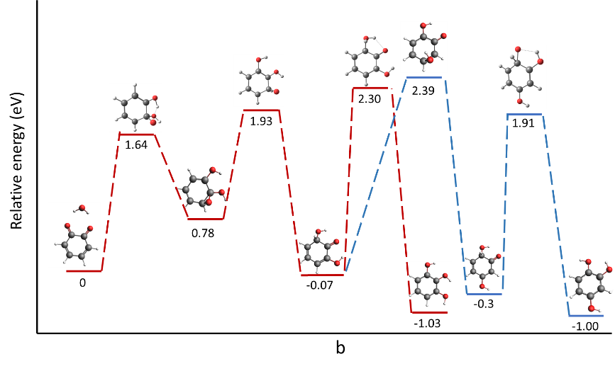
Michael addition reaction of BQ

Slide 13
Summary
We have developed a (semi-)automated framework to study degradation of solvated molecules
  Identified active atoms using local reactivity analysis
  Generated encounter complexes
  Explored the free energy landscape via a one-ended process search
Providing fundamental insights for mitigating electrolyte degradation

Slide 14
